Slide 1
Lesson 10 Calculus and the squeeze theorem
Mathematics Extension 2 · Proof · ME2-12-01
Learning intention
Success criteria · I can…
Activities & tasks
To prove inequalities using calculus, and to use inequalities to find limits with the squeeze theorem.
prove $f\left(x\right)≥g\left(x\right)$ by studying $h\left(x\right)=f\left(x\right)−g\left(x\right)$ and its derivative
use a minimum value, concavity or a known inequality in a proof
state the squeeze theorem and use it to find limits
prove $\lim_{x→0}\frac{sinx}{x}=1$
Howard’s 1000 Extension 2 Revision Questions
Suggested practice: Howard’s 1000 Extension 2 Revision Questions
McIntyre Maths · Mathematics Extension 2 · Lesson 10 Calculus and the squeeze theorem
1

Slide 2

Warm-up
WARM-UP
(a) Find the minimum value of $f\left(x\right)=e^{x}−1−x$.
(b) If $h\left(0\right)=0$ and $h′\left(x\right)>0$ for $x>0$, what can you say about $h\left(x\right)$ for $x>0$?
(c) Evaluate $\lim_{x→∞}\frac{1}{x}$ and $\lim_{x→0}x^{2}$.
(d) Since $−1≤sinx≤1$, find bounds for $\frac{sinx}{x}$ when $x>0$.
McIntyre Maths · Mathematics Extension 2 · Lesson 10 Calculus and the squeeze theorem
2

Slide 3

Inequalities using calculus
METHOD
Three strategies for proving $f\left(x\right)≥g\left(x\right)$
1. Start and slope: let $h\left(x\right)=f\left(x\right)−g\left(x\right)$. Show $h\left(a\right)=0$ and $h′\left(x\right)≥0$ for $x≥a$. So $h\left(x\right)≥0$ for $x≥a$.
2. Global minimum: show the minimum value of $h\left(x\right)$ on the domain is $≥0$.
3. Graphs and concavity: a concave down curve lies above its chords and below its tangents (and the reverse for concave up).
Example 1
Prove that $ln\left(1+x\right)<x$ for all $x>0$.
McIntyre Maths · Mathematics Extension 2 · Lesson 10 Calculus and the squeeze theorem
3

Slide 4

Example 2 · Trigonometric inequalities
EXAMPLE
(a) Prove that $sinx<x$ for all $x>0$.
(b) Prove that $cosx≥1−\frac{x^{2}}{2}$ for all real $x$.
McIntyre Maths · Mathematics Extension 2 · Lesson 10 Calculus and the squeeze theorem
4

Slide 5

HSC practice · From a function inequality to a sequence
HSC PRACTICE
2023 HSC Q16(b)
(i) Show that $x>lnx$ for all $x>0$.
(ii) Hence, or otherwise, show that $e^{n^{2}+n}>{\left(n!\right)}^{2}$ for all positive integers $n$.
McIntyre Maths · Mathematics Extension 2 · Lesson 10 Calculus and the squeeze theorem
5

Slide 6
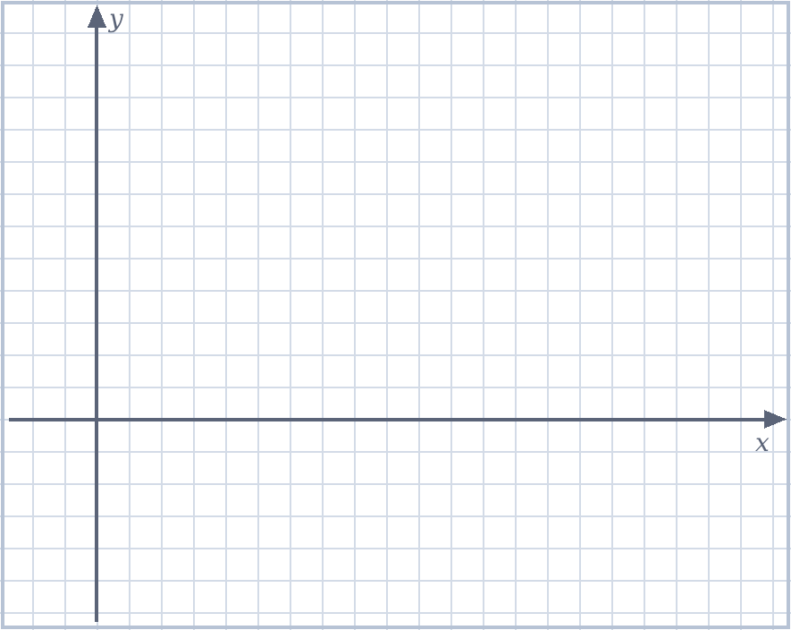
Example 3 · Concavity and a famous comparison
EXAMPLE
(a) Use concavity to prove that $sinx≥\frac{2x}{π}$ for $0≤x≤\frac{π}{2}$.
(b) By finding the maximum of $f\left(x\right)=\frac{lnx}{x}$, prove that $π^{e}<e^{π}$.
McIntyre Maths · Mathematics Extension 2 · Lesson 10 Calculus and the squeeze theorem
6

Slide 7

Exam-style · Bounds for the harmonic series
EXAM-STYLE
(i) Show that $\frac{x}{1+x}<ln\left(1+x\right)<x$ for $x>0$.
(ii) By putting $x=\frac{1}{k}$, show that $\frac{1}{k+1}<ln\left(\frac{k+1}{k}\right)<\frac{1}{k}$.
(iii) Hence show that $ln\left(n+1\right)<1+\frac{1}{2}+\frac{1}{3}+⋯+\frac{1}{n}<1+lnn$ for all integers n ≥ 2.
McIntyre Maths · Mathematics Extension 2 · Lesson 10 Calculus and the squeeze theorem
7

Slide 8

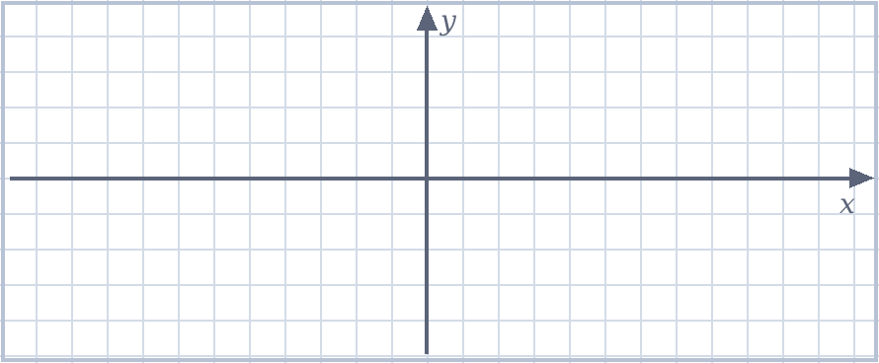
The squeeze theorem
THEOREM
Squeeze theorem (limit version)
If $f\left(x\right)≤g\left(x\right)≤h\left(x\right)$ for all $x$ near $k$ (or for all large $x$), and $\lim_{x→k}f\left(x\right)=\lim_{x→k}h\left(x\right)=L$, then $\lim_{x→k}g\left(x\right)=L$.
Typical source of the bounds: $−1≤sinθ≤1$, $−1≤cosθ≤1$, or an inequality proved earlier.
Example 4
Find $\lim_{x→0}x^{2}sin\left(\frac{1}{x}\right)$.
McIntyre Maths · Mathematics Extension 2 · Lesson 10 Calculus and the squeeze theorem
8

Slide 9

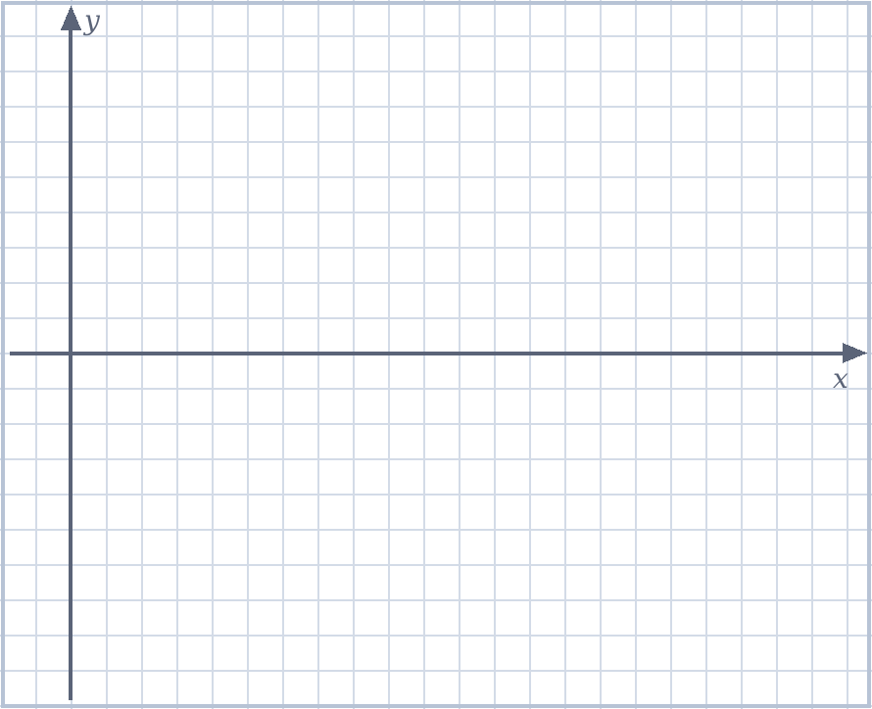
Example 5 · A limit at infinity
EXAMPLE
Use the squeeze theorem to find $\lim_{x→∞}\frac{sinx}{x}$.
McIntyre Maths · Mathematics Extension 2 · Lesson 10 Calculus and the squeeze theorem
9

Slide 10
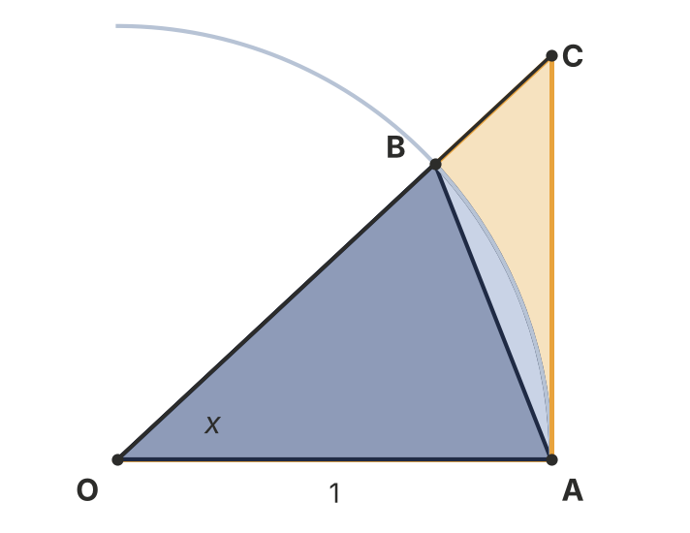

Example 6 · The fundamental trigonometric limit
EXAMPLE
Why not use Example 2? Those proofs use $d/dx$(sin x) = cos x, which is proved from this limit. Using them here would be circular, so we use areas.
(i) In the unit circle, $B=(cos x,sin x)$ and $C$ lies on $OB$ extended, on the tangent at $A$. Compare the areas of △OAB, sector OAB and △OAC to prove $sin x<x<tan x$ for $0<x<\frac{π}{2}$.
(ii) Hence show that $cos x<\frac{sin x}{x}<1$ for $0<x<\frac{π}{2}$.
(iii) Hence prove that $\lim_{x→0}\frac{sin x}{x}=1$.
McIntyre Maths · Mathematics Extension 2 · Lesson 10 Calculus and the squeeze theorem
10

Slide 11

Spot the flaw · Circular reasoning
SPOT THE FLAW
A student wrote this. Find the flaw, explain why it matters, then write a correct version.
Claim. $\lim_{x→0}\frac{sin x}{x}=1$.
1. $\lim_{x→0}\frac{sin x}{x}=\lim_{x→0}\frac{sin x-sin 0}{x-0}$
2. This is the derivative of $sin x$ at $x=0$, which is $cos 0=1$. □
McIntyre Maths · Mathematics Extension 2 · Lesson 10 Calculus and the squeeze theorem
11

Slide 12

HSC practice · Squeezing a series to e
HSC PRACTICE
Adapted from 2022 HSC Q14(b)(v)
It can be shown that for all integers $n≥0$: $0≤1−\frac{1}{e}\sum_{r=0}^{n}{\frac{1}{r!}}≤\frac{1}{\left(n+1\right)!}$.
Use this to show that $\lim_{n→∞}\sum_{r=0}^{n}{\frac{1}{r!}}=e$.
McIntyre Maths · Mathematics Extension 2 · Lesson 10 Calculus and the squeeze theorem
12

Slide 13

Which method? · The whole unit
MIXED PRACTICE
For each statement, name the method you would use and write the first line of the proof. Then prove any two.
(a) $1+3+5+…+(2n-1)=n^{2}$ for $n≥1$.
(b) $e^{x}≥1+x$ for all real $x$.
(c) $3^{n}>n^{3}$ for all integers $n≥4$.
(d) $\log_{3} 7$ is irrational.
(e) $\lim_{x→∞}\frac{cos x}{x^{2}}=0$.
(f) For integers $n$, if $n^{3}$ is even, then $n$ is even.
McIntyre Maths · Mathematics Extension 2 · Lesson 10 Calculus and the squeeze theorem
13

Slide 14

Exit ticket
EXIT TICKET
Using $cosx≥1−\frac{x^{2}}{2}$ (Example 2), prove that $sinx>x−\frac{x^{3}}{6}$ for all $x>0$.
Suggested practice: Howard’s 1000 Extension 2 Revision Questions
McIntyre Maths · Mathematics Extension 2 · Lesson 10 Calculus and the squeeze theorem
14

