Slide 1
Lesson 9 Lines and circles in the Argand diagram
Mathematics Extension 2 · Complex Numbers I · ME2-12-03
Learning intention
Success criteria · I can…
Activities & tasks
To sketch and describe loci defined by modulus conditions: circles and perpendicular bisectors.
read $\left|z−z_{1}\right|$ as the distance from $z$ to $z_{1}$
graph $\left|z−z_{1}\right|=r$ and the regions $\left|z−z_{1}\right|<r$, $\left|z−z_{1}\right|>r$
graph $\left|z−z_{1}\right|=\left|z−z_{2}\right|$ and give its equation and a geometric description
find a Cartesian equation by letting $z=x+iy$
find a locus of $w$ given a condition on $z$
Howard’s 1000 Extension 2 Revision Questions
Complex Locus Lab
Loci in the Argand Diagram (Wolfram Demonstrations)
McIntyre Maths · Mathematics Extension 2 · Lesson 9 Lines and circles in the Argand diagram
1

Slide 2

Warm-up · Retrieval and coordinate geometry
WARM-UP
(a) Write the equation of the circle with centre $\left(1,−2\right)$ and radius $3$.
(b) Find the perpendicular bisector of the interval from $\left(0,0\right)$ to $\left(4,2\right)$.
(c) Find $\left|3−4i\right|$.
(d) Write $z+2−i$ in the form $z−\left( \right)$.
McIntyre Maths · Mathematics Extension 2 · Lesson 9 Lines and circles in the Argand diagram
2

Slide 3

Circles
DEFINITION
Modulus is distance
$\left|z−z_{1}\right|$ is the distance from $Z$ to $Z_{1}$. So $\left|z−z_{1}\right|=r$ is the circle with centre $z_{1}$ and radius $r$.
$\left|z−z_{1}\right|<r$ is the inside (dashed boundary); $\left|z−z_{1}\right|≥r$ is the outside including the circle (solid).
Write $\left|z+3−i\right|$ as $\left|z−\left(−3+i\right)\right|$ to read off the centre.
McIntyre Maths · Mathematics Extension 2 · Lesson 9 Lines and circles in the Argand diagram
3

Slide 4
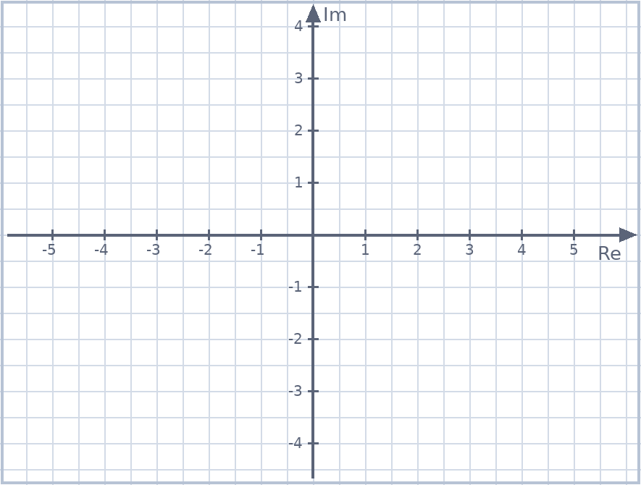
Example 1 · Sketching circles
EXAMPLE
Sketch, and write the Cartesian equation.
(a) $\left|z\right|=3$
(b) $\left|z−\left(1−2i\right)\right|=2$
McIntyre Maths · Mathematics Extension 2 · Lesson 9 Lines and circles in the Argand diagram
4

Slide 5
Example 2 · Regions bounded by circles
EXAMPLE
Sketch each region. Take care with the boundary.
(a) $\left|z+3−i\right|≤2$
(b) $\left|z−2i\right|>1$
McIntyre Maths · Mathematics Extension 2 · Lesson 9 Lines and circles in the Argand diagram
5

Slide 6

Perpendicular bisectors
DEFINITION
Equidistant from two points
$\left|z−z_{1}\right|=\left|z−z_{2}\right|$: $Z$ is the same distance from $Z_{1}$ and $Z_{2}$, so the locus is the perpendicular bisector of $Z_{1}Z_{2}$.
Find its equation by: midpoint and perpendicular gradient or let $z=x+iy$, square both sides, simplify.
McIntyre Maths · Mathematics Extension 2 · Lesson 9 Lines and circles in the Argand diagram
6

Slide 7

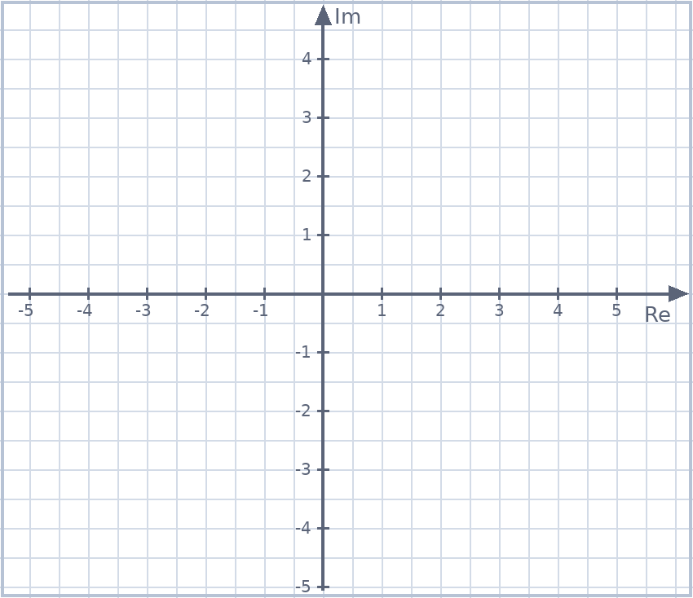
Example 3 · A perpendicular bisector
EXAMPLE
Sketch $\left|z−\left(1+i\right)\right|=\left|z−\left(2−i\right)\right|$ and find its Cartesian equation using two methods.
McIntyre Maths · Mathematics Extension 2 · Lesson 9 Lines and circles in the Argand diagram
7

Slide 8

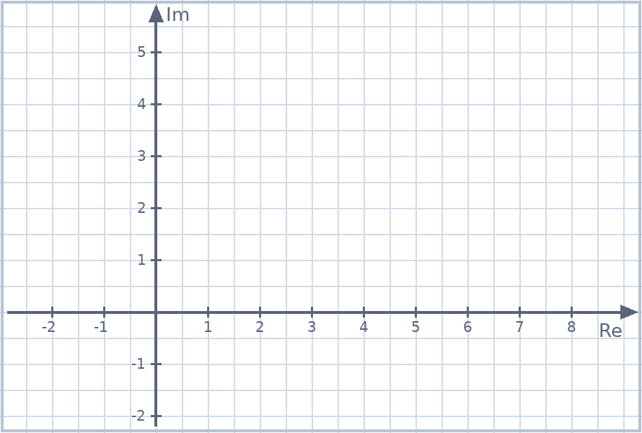
Example 4 · A circle and a line
TRIAL PRACTICE
2024 Trial (Hurlstone) Q11(d)
(i) On the same diagram sketch $\left|z−\left(3+2i\right)\right|=2$ and $\left|z+3\right|=\left|z−5\right|$.
(ii) Find the complex number(s) satisfying both equations.
McIntyre Maths · Mathematics Extension 2 · Lesson 9 Lines and circles in the Argand diagram
8

Slide 9

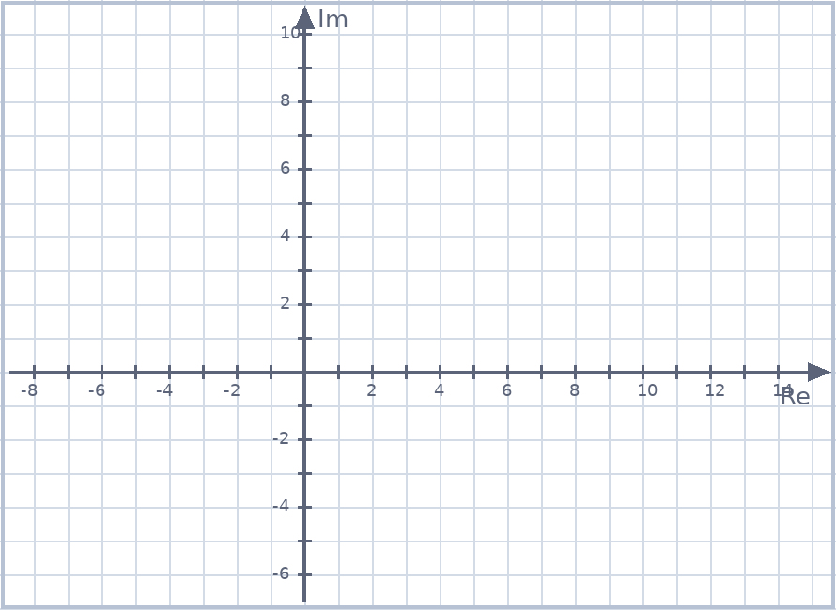
Example 5 · Touching circles
TRIAL PRACTICE
2024 Trial (Hurlstone) Q11(d)(iii)
For what values of $k>0$ does the circle $\left|z−2i\right|=k$ meet $\left|z−\left(3+2i\right)\right|=2$ at exactly one point?
McIntyre Maths · Mathematics Extension 2 · Lesson 9 Lines and circles in the Argand diagram
9

Slide 10

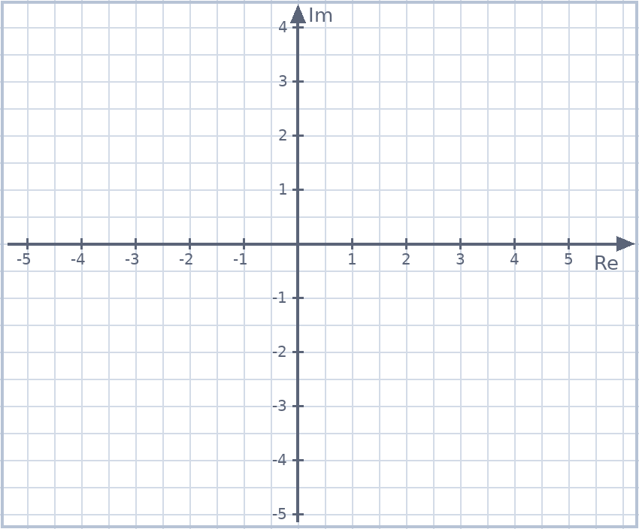
Example 6 · The locus of w
EXAMPLE
Find the locus of $w$ if $w=\frac{z−1}{z}$ and $\left|z\right|=2$.
McIntyre Maths · Mathematics Extension 2 · Lesson 9 Lines and circles in the Argand diagram
10

Slide 11
Example 7 · Purely imaginary
EXAMPLE
Find the locus of $z$ if $w=\frac{z−2}{z}$ is purely imaginary.
McIntyre Maths · Mathematics Extension 2 · Lesson 9 Lines and circles in the Argand diagram
11

Slide 12

Example 8 · Extension: not a straight line
EXTENSION
Describe the locus given by $\left|z+2\right|=2\left|z−2+i\right|$.
McIntyre Maths · Mathematics Extension 2 · Lesson 9 Lines and circles in the Argand diagram
12

Slide 13

Spot the error · Circles and bisectors
SPOT THE ERROR
Each statement is wrong. Find the error and correct it.
(a) $\left|z+3−i\right|=2$ is a circle with centre $\left(3,−1\right)$.
(b) $\left|z−2i\right|<1$ is drawn with a solid boundary.
(c) $\left|2z−4i\right|=6$ is a circle with radius $6$.
(d) $\left|z−1\right|=\left|z−i\right|$ is the circle through $1$ and $i$.
McIntyre Maths · Mathematics Extension 2 · Lesson 9 Lines and circles in the Argand diagram
13

Slide 14
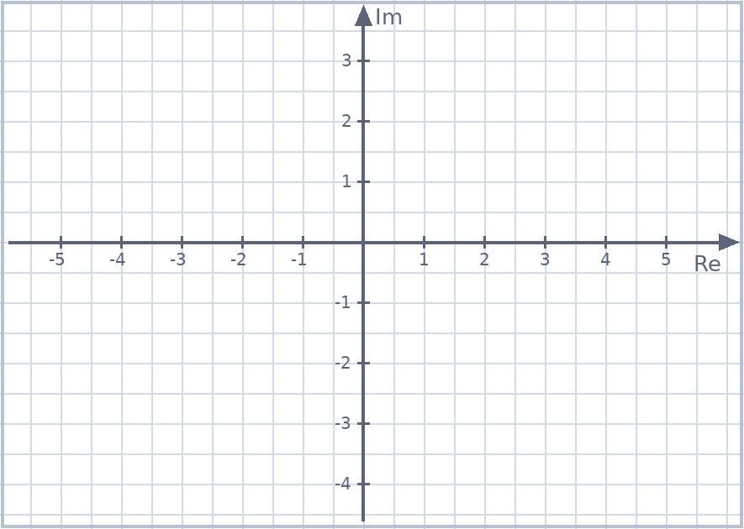
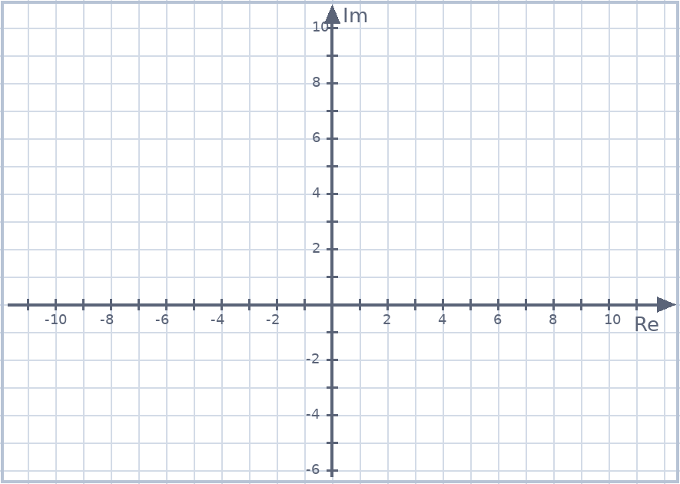
Exit ticket
EXIT TICKET
1. Sketch $\left|z−1−i\right|=\left|z+1+i\right|$ and give its equation.
2. Write the Cartesian equation of $\left|2z−4i\right|=6$ and sketch it.
Suggested practice: Howard’s 1000 Extension 2 Revision Questions
McIntyre Maths · Mathematics Extension 2 · Lesson 9 Lines and circles in the Argand diagram
14

