Slide 1
Lesson 8 Rotation, dilation and geometry
Mathematics Extension 2 · Complex Numbers I · ME2-12-03
Learning intention
Success criteria · I can…
Activities & tasks
To interpret multiplication as a rotation and dilation, and use it to solve geometry problems.
explain why multiplying by $i$ rotates ${90}^{∘}$ anticlockwise about $O$
multiply by $r cis θ$ to dilate by $r$ and rotate by $θ$
rotate about a point other than $O$: $c−a=\left(b−a\right) cis θ$
find unknown vertices of squares and equilateral triangles
prove geometric results with complex numbers
Howard’s 1000 Extension 2 Revision Questions
McIntyre Maths · Mathematics Extension 2 · Lesson 8 Rotation, dilation and geometry
1

Slide 2

Warm-up · Retrieval from Lessons 5–7
WARM-UP
(a) Find $iz$ for $z=3−2i$.
(b) Write $cos\frac{π}{3}+isin\frac{π}{3}$ as $x+iy$.
(c) $Z$ is $1+i$ and $W$ is $3+4i$. Which number does $\vec{WZ}$ represent?
(d) Find the length $WZ$ in (c).
McIntyre Maths · Mathematics Extension 2 · Lesson 8 Rotation, dilation and geometry
2

Slide 3

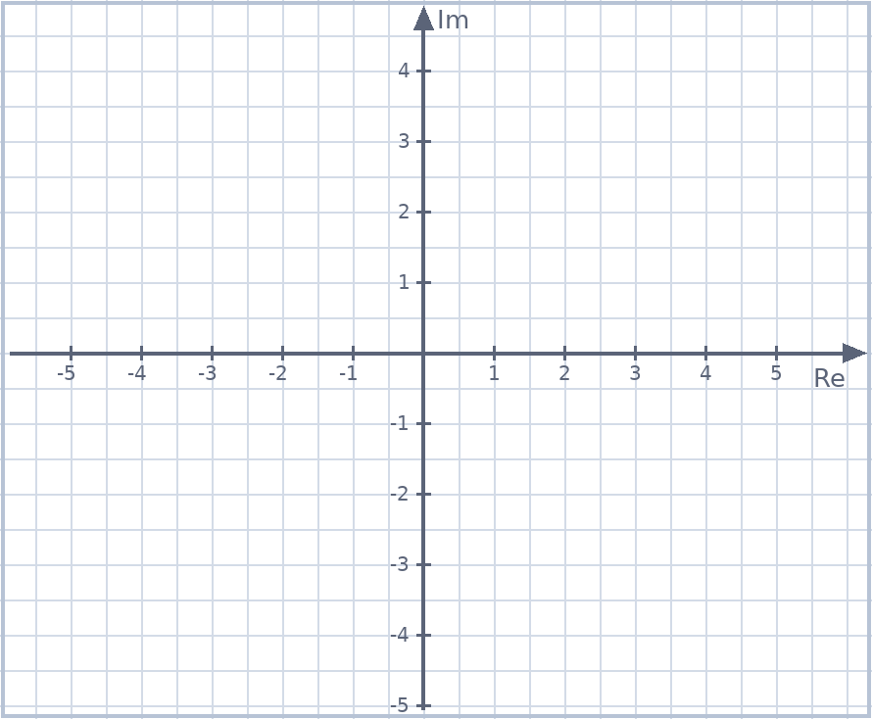
Example 1 · Multiplying by i
EXAMPLE
Let $z=2+i$. Plot $z$, $iz$, $i^{2}z=−z$ and $i^{3}z=−iz$. Describe what multiplying by $i$ does.
McIntyre Maths · Mathematics Extension 2 · Lesson 8 Rotation, dilation and geometry
3

Slide 4

Multiplication as rotation and dilation
DEFINITION
Multiplying by $w=r cis θ$
$zw$ has modulus $r\left|z\right|$ and argument $argz+θ$: dilate by factor $r$ and rotate by $θ$ about $O$.
To rotate $\vec{AB}$ about $A$ by $θ$ (same length) to get $\vec{AC}$: $c−a=\left(b−a\right) cis θ$
Anticlockwise ${90}^{∘}$: multiply by $i$. Clockwise ${90}^{∘}$: multiply by $−i$.
McIntyre Maths · Mathematics Extension 2 · Lesson 8 Rotation, dilation and geometry
4

Slide 5

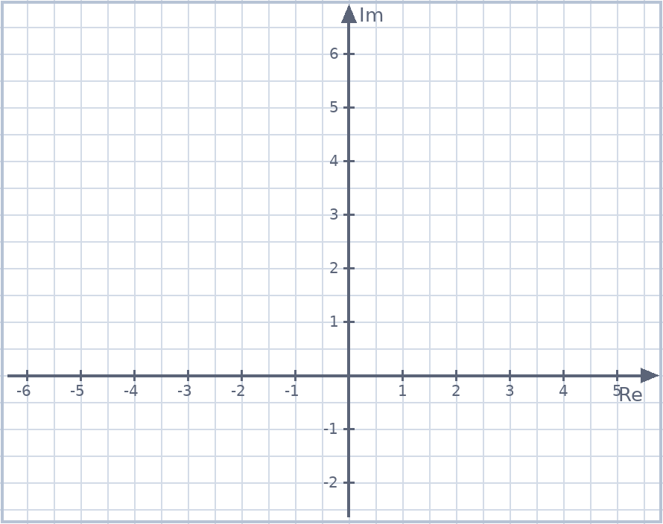
Example 2 · Rotate and enlarge
EXAMPLE
Let $z=2+2i$. Find the complex number obtained by rotating $z$ anticlockwise by $\frac{π}{3}$ about $O$ and doubling its distance from $O$.
McIntyre Maths · Mathematics Extension 2 · Lesson 8 Rotation, dilation and geometry
5

Slide 6

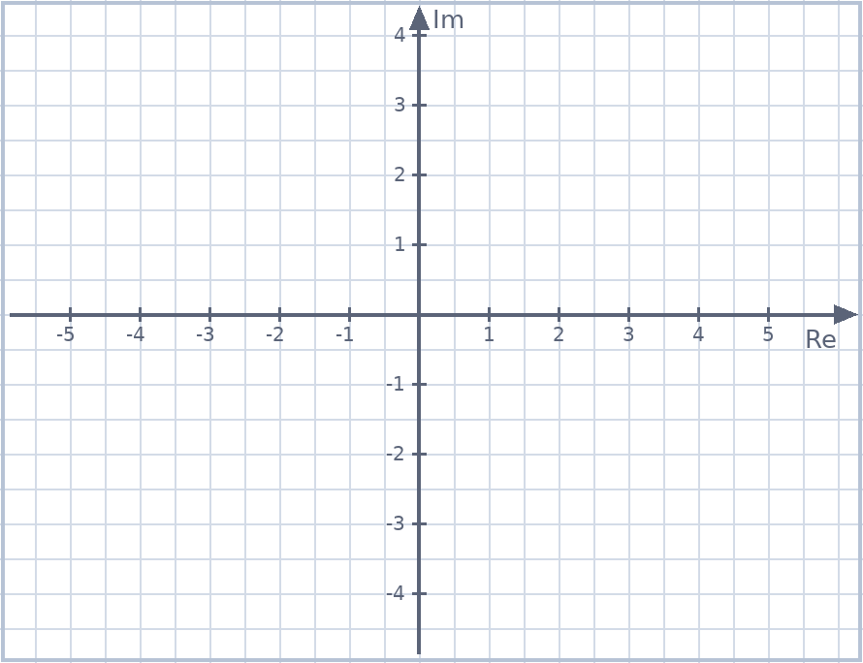
Example 3 · A square
EXAMPLE
$OABC$ is a square, labelled anticlockwise, with $A$ at $2+i$.
(a) Find $C$ and $B$. (b) The square is rotated ${45}^{∘}$ anticlockwise about $O$. Find the new position of $B$.
McIntyre Maths · Mathematics Extension 2 · Lesson 8 Rotation, dilation and geometry
6

Slide 7
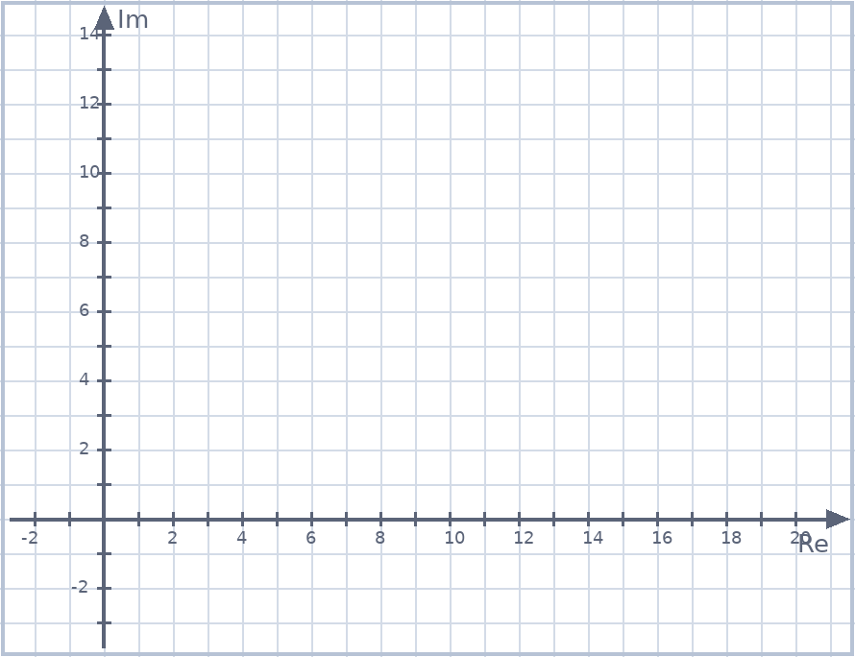
Example 4 · Rotating about another point
EXAMPLE
In triangle $ABC$, $AB=BC$ and $∠ABC={90}^{∘}$. $B$ is $5+3i$ and $C$ is $9+6i$, and $A$ lies above the line $BC$.
Find the complex number represented by $A$.
McIntyre Maths · Mathematics Extension 2 · Lesson 8 Rotation, dilation and geometry
7

Slide 8

Example 5 · Equilateral triangle
HSC PRACTICE
Adapted from 2020 HSC Q14(a)
$O$, $A$ and $B$ represent $0$, $z_{1}$ and $z_{2}$, where $z_{2}=\left(cos\frac{π}{3}+isin\frac{π}{3}\right)z_{1}$.
(i) Explain why $△OAB$ is equilateral. (ii) Show that $z_{1}^{2}−z_{1}z_{2}+z_{2}^{2}=0$.
McIntyre Maths · Mathematics Extension 2 · Lesson 8 Rotation, dilation and geometry
8

Slide 9
Example 6 · Perpendicular vectors
HSC PRACTICE
Adapted from 2024 HSC Q14(c)
$z$ and $w$ are non-zero with $arg\left(\frac{z}{w}\right)=−\frac{π}{2}$.
(i) Prove that $\left|\frac{z−w}{z+w}\right|=1$. (ii) Interpret this result geometrically.
McIntyre Maths · Mathematics Extension 2 · Lesson 8 Rotation, dilation and geometry
9

Slide 10

Example 7 · Proving a quadrilateral is a square
EXAMPLE
The vertices $A$, $B$, $C$, $D$ of a quadrilateral represent $z_{1}$, $z_{2}$, $z_{3}$, $z_{4}$.
(a) If $z_{1}−z_{2}=z_{4}−z_{3}$, show that $ABCD$ is a parallelogram. (b) If also $z_{3}−z_{2}=i\left(z_{1}−z_{2}\right)$, show that $ABCD$ is a square.
McIntyre Maths · Mathematics Extension 2 · Lesson 8 Rotation, dilation and geometry
10

Slide 11
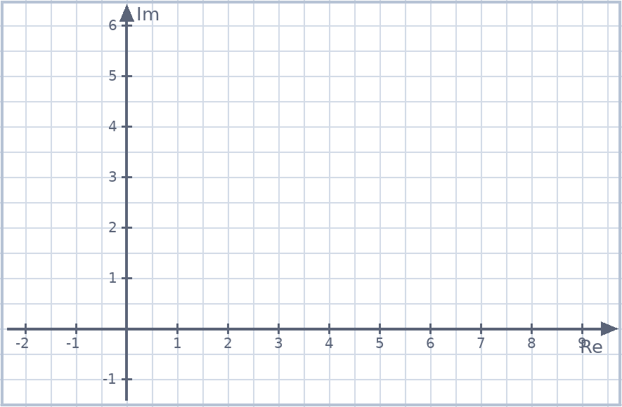
Exit ticket
EXIT TICKET
1. $O$, $2$ and $z$ form an equilateral triangle with $z$ in the first quadrant. Find $z$.
2. $ABCD$ is a square labelled anticlockwise, with $A$ at $1+i$ and $B$ at $4+2i$. Find $C$ and $D$.
Suggested practice: Howard’s 1000 Extension 2 Revision Questions
McIntyre Maths · Mathematics Extension 2 · Lesson 8 Rotation, dilation and geometry
11

