Slide 1
Lesson 7 Complex numbers as vectors
Mathematics Extension 2 · Complex Numbers I · ME2-12-03
Learning intention
Success criteria · I can…
Activities & tasks
To represent complex numbers as vectors and interpret addition and subtraction geometrically.
represent $z$ as a vector with length $\left|z\right|$ and direction $argz$
add (parallelogram, tip to tail) and subtract vectors on the Argand diagram
use $\left|z−w\right|$ as the distance $WZ$ and $arg\left(z−w\right)$ as the direction of $\vec{WZ}$
prove and use the triangle inequality $\left|z_{1}+z_{2}\right|≤\left|z_{1}\right|+\left|z_{2}\right|$
Howard’s 1000 Extension 2 Revision Questions
Complex Locus Lab
McIntyre Maths · Mathematics Extension 2 · Lesson 7 Complex numbers as vectors
1

Slide 2

Warm-up · Retrieval from Lessons 4–6
WARM-UP
(a) Find $\left|z\right|$ if $z=\left(3+4i\right)\left(1−i\right)$.
(b) Find $Arg\left(z_{1}z_{2}\right)$ if $argz_{1}=\frac{3π}{4}$, $argz_{2}=\frac{π}{2}$.
(c) For $\underset{∼}{a}=3\underset{∼}{i}+2\underset{∼}{j}$ and $\underset{∼}{b}=\underset{∼}{i}−2\underset{∼}{j}$, find $\underset{∼}{a}+\underset{∼}{b}$ and $\underset{∼}{a}−\underset{∼}{b}$.
(d) Plot $z=−1+2i$ and $iz$. Through what angle has $z$ turned about $O$?
McIntyre Maths · Mathematics Extension 2 · Lesson 7 Complex numbers as vectors
2

Slide 3

Complex numbers as vectors
DEFINITION
Vectors on the Argand diagram
$z=x+iy$ is represented by the vector $\vec{OZ}$ — or by any vector with the same length $\left|z\right|$ and direction $argz$.
The vector from $W$ to $Z$ represents $z−w$: "head minus tail".
$z+w$ is the diagonal $\vec{OC}$ of the parallelogram with sides $\vec{OA}=z$ and $\vec{OB}=w$ — or place $w$ at the tip of $z$ ("tip to tail").
McIntyre Maths · Mathematics Extension 2 · Lesson 7 Complex numbers as vectors
3

Slide 4

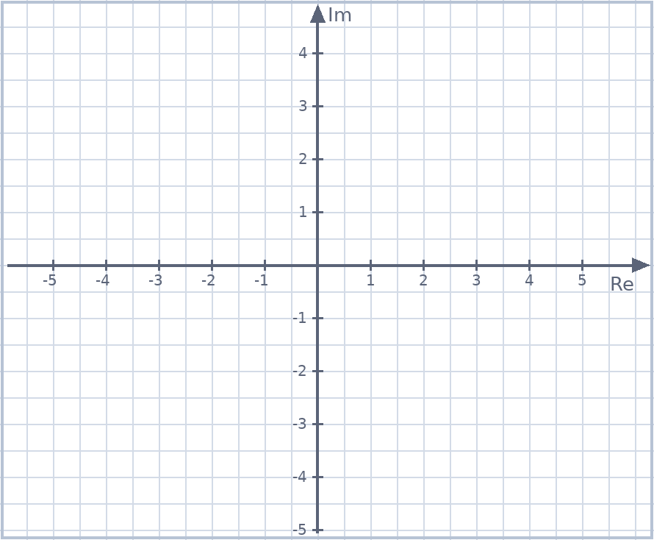
Example 1 · A vector between two points
EXAMPLE
Plot $z=3+4i$ and $\overline{z}$ as vectors from $O$. Draw the vector from $Z$ to $\overline{Z}$. Which complex number does it represent?
McIntyre Maths · Mathematics Extension 2 · Lesson 7 Complex numbers as vectors
4

Slide 5

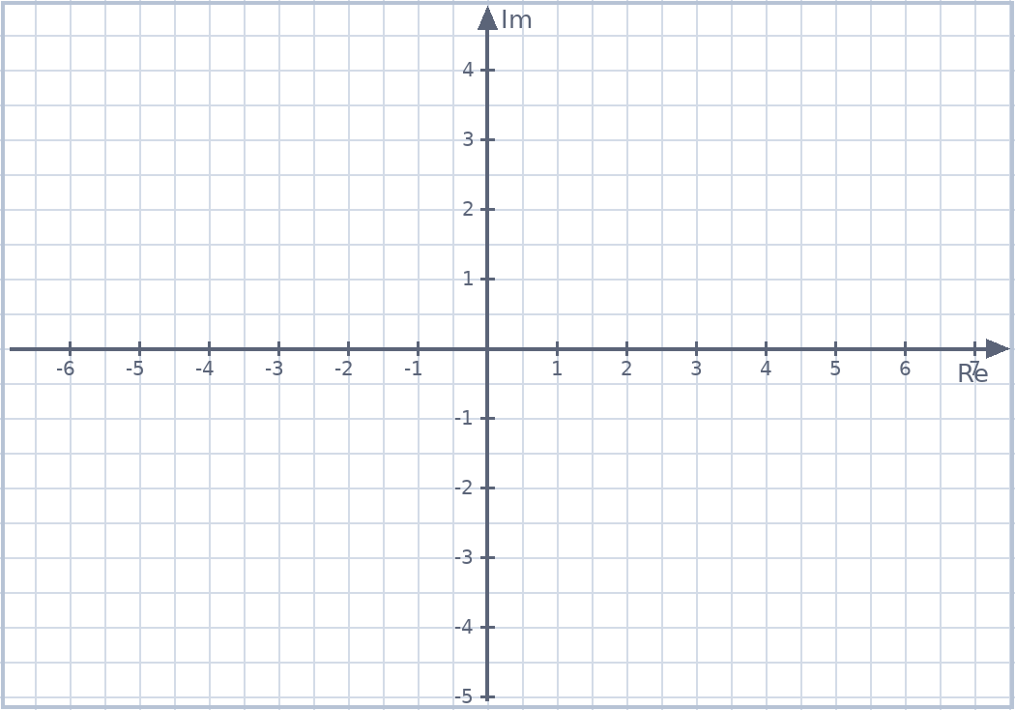
Example 2 · Adding on the Argand diagram
EXAMPLE
(a) Show $\left(1+2i\right)+\left(3+i\right)$ on the Argand diagram. (b) If $z=1+3i$ and $w=4+i$, plot $z$, $w$, $−z$ and $z+w$.
McIntyre Maths · Mathematics Extension 2 · Lesson 7 Complex numbers as vectors
5

Slide 6
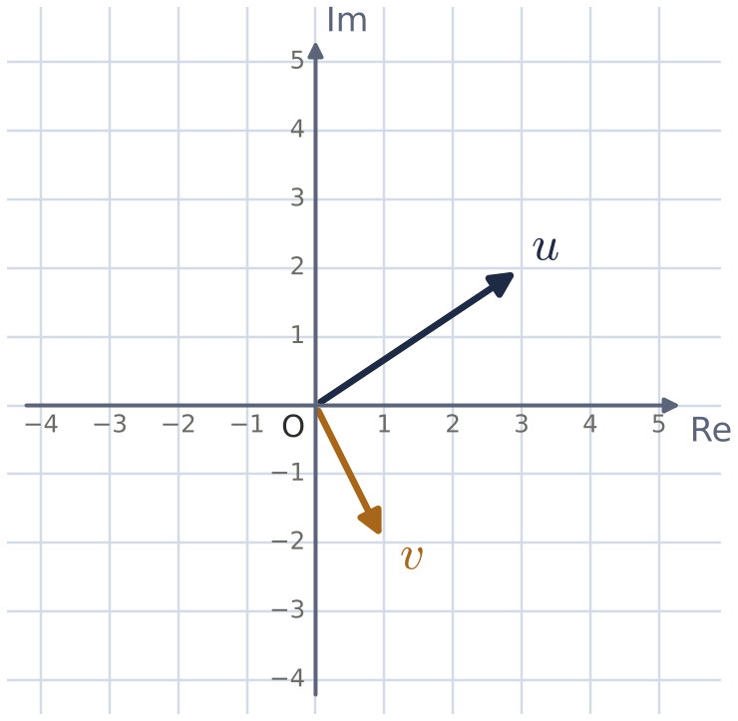

Example 3 · Subtraction, tip to tail
EXAMPLE
The diagram shows $u$ and $v$. On the same diagram draw the vectors representing
1. $u+v$ 2. $u−v$ 3. $v−u$
McIntyre Maths · Mathematics Extension 2 · Lesson 7 Complex numbers as vectors
6

Slide 7

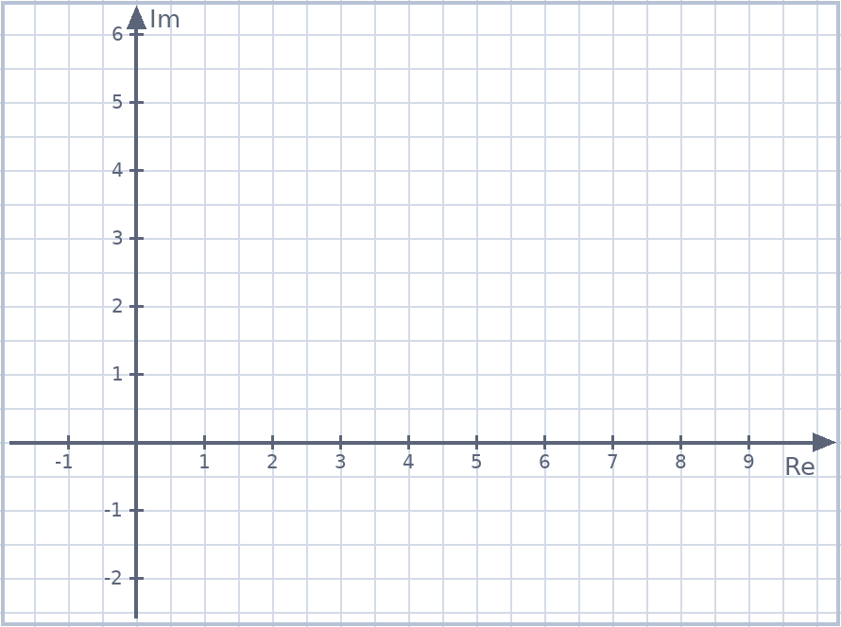
Example 4 · Distance and direction
EXAMPLE
$\left|z−w\right|$ is the distance $WZ$, and $arg\left(z−w\right)$ is the angle $\vec{WZ}$ makes with the positive real direction.
$OABC$ is a parallelogram with $A$ at $5+i$ and $C$ at $2+3i$. Find (a) $B$ (b) $\vec{AC}$ (c) $\vec{CA}$ (d) the lengths of both diagonals.
McIntyre Maths · Mathematics Extension 2 · Lesson 7 Complex numbers as vectors
7

Slide 8

The triangle inequality
DEFINITION
Triangle inequality
$$\left|z_{1}+z_{2}\right|≤\left|z_{1}\right|+\left|z_{2}\right|$$
Equality holds when $z_{1}$ and $z_{2}$ point in the same direction (or one is $0$).
Example 5
Prove the triangle inequality (a) geometrically, using the parallelogram (b) algebraically, using ${\left|z\right|}^{2}=z\overline{z}$.
McIntyre Maths · Mathematics Extension 2 · Lesson 7 Complex numbers as vectors
8

Slide 9

Example 6 · Using the triangle inequality
EXAMPLE
Howard Rev Q85
Adapted from 2020 HSC Q9
(a) Given $\left|z\right|<\frac{1}{2}$, show that $\left|\left(1+i\right)z^{3}+iz\right|<\frac{3}{4}$.
(b) $z$ moves on the circle $\left|z\right|=1$. Find the greatest value of $\left|z+2\right|+\left|z−2\right|$.
McIntyre Maths · Mathematics Extension 2 · Lesson 7 Complex numbers as vectors
9

Slide 10

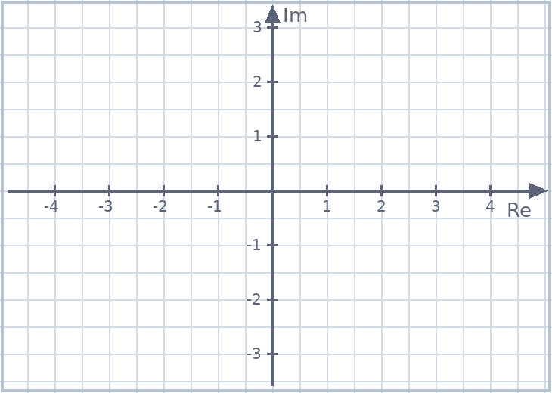
HSC practice · Adding unit vectors
HSC PRACTICE
Adapted from 2023 HSC Q14(a)
Let $z=\frac{\sqrt{3}}{2}+\frac{1}{2}i$ and $w=−\frac{\sqrt{2}}{2}+\frac{\sqrt{2}}{2}i$. (i) Write $z$ and $w$ in polar form.
(ii) Show that ${\left|z+w\right|}^{2}=\frac{4+\sqrt{2}−\sqrt{6}}{2}$. (iii) $A$ and $C$ represent $z$ and $z+w$. Explain why $∠AOC=\frac{7π}{24}$, and hence find $cos\frac{7π}{24}$.
McIntyre Maths · Mathematics Extension 2 · Lesson 7 Complex numbers as vectors
10

Slide 11

Exit ticket
EXIT TICKET
1. $Z$ is $2+i$ and $W$ is $−1+5i$. Find the complex number represented by $\vec{WZ}$ and the length $WZ$.
2. Explain geometrically why $\left|z+w\right|=\left|z−w\right|$ exactly when $OZ⊥OW$.
Suggested practice: Howard’s 1000 Extension 2 Revision Questions
McIntyre Maths · Mathematics Extension 2 · Lesson 7 Complex numbers as vectors
11

