Slide 1
Lesson 5 Modulus–argument form
Mathematics Extension 2 · Complex Numbers I · ME2-12-03
Learning intention
Success criteria · I can…
Activities & tasks
To represent complex numbers in modulus–argument (polar) form and convert between forms.
find $\left|z\right|$ and $argz$, and the principal argument $Arg z∈(−π,π]$
write $z=r\left(cosθ+isinθ\right)$ using a sketch to choose the quadrant
convert from polar form to Cartesian form with exact values
write $\overline{z}$ and $−z$ in polar form
Howard’s 1000 Extension 2 Revision Questions
McIntyre Maths · Mathematics Extension 2 · Lesson 5 Modulus–argument form
1

Slide 2

Warm-up · Exact values
WARM-UP
(a) $\tan^{−1}\sqrt{3}$
(b) $cos\frac{2π}{3}$
(c) $sin\left(−\frac{3π}{4}\right)$
(d) Find $θ∈(−π,π]$ with $cosθ=−\frac{1}{2}$ and $sinθ=−\frac{\sqrt{3}}{2}$.
McIntyre Maths · Mathematics Extension 2 · Lesson 5 Modulus–argument form
2

Slide 3

Modulus and argument
DEFINITION
Polar (modulus–argument) form
Modulus $r=\left|z\right|=\sqrt{x^{2}+y^{2}}$ Argument $argz=θ$ where $cosθ=\frac{x}{r}$, $sinθ=\frac{y}{r}$ (many values, $2π$ apart)
Principal argument $Arg z$ is the one value in $(−π,π]$. $arg0$ is undefined.
$$z=r\left(cosθ+isinθ\right)=r cis θ$$
$cis θ$ is shorthand for working only. NESA and HSC papers write $r\left(cosθ+isinθ\right)$: give final answers in that form, with $θ$ in radians.
Discuss
(a) Sketch: mark $r$ and $θ$ for a point $z=x+iy$ in each quadrant.
(b) Write three different values of $arg\left(1+i\right)$. Which one is $Arg\left(1+i\right)$?
McIntyre Maths · Mathematics Extension 2 · Lesson 5 Modulus–argument form
3

Slide 4

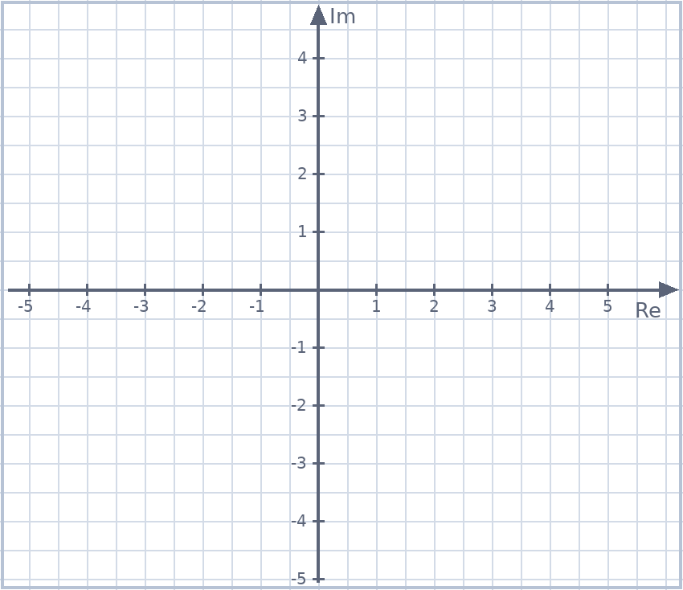
Example 1 · Cartesian to polar
EXAMPLE
Plot $z=3+4i$. Find $\left|z\right|$ and $Arg z$, and write $z$ in modulus–argument form. Repeat for $\overline{z}=3−4i$.
McIntyre Maths · Mathematics Extension 2 · Lesson 5 Modulus–argument form
4

Slide 5

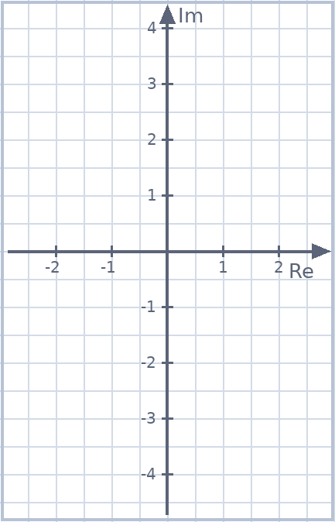
Example 2 · Second and third quadrants
EXAMPLE
Write in modulus–argument form using the principal argument. Sketch first!
(a) $−1+i$
(b) $−1−\sqrt{3} i$
McIntyre Maths · Mathematics Extension 2 · Lesson 5 Modulus–argument form
5

Slide 6

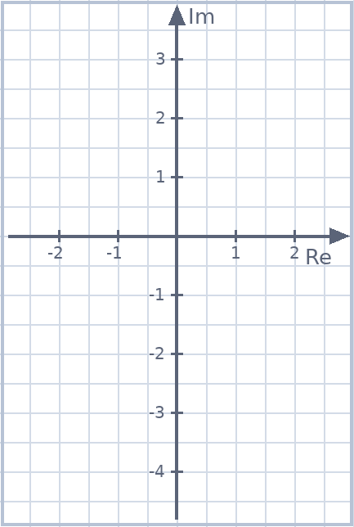
Example 3 · Choosing the quadrant
EXAMPLE
2024 Trial (Hurlstone) Q11(b)
(a) Find $Arg\left(\sqrt{6}−\sqrt{2} i\right)$.
(b) Write $−4−3i$ in polar form, with $Arg$ correct to 2 decimal places.
McIntyre Maths · Mathematics Extension 2 · Lesson 5 Modulus–argument form
6

Slide 7

Example 4 · On the axes
EXAMPLE
Write in modulus–argument form using the principal argument.
(a) $5i$
(b) $−4$
(c) $−\frac{i}{2}$
McIntyre Maths · Mathematics Extension 2 · Lesson 5 Modulus–argument form
7

Slide 8

Example 5 · Polar to Cartesian
EXAMPLE
Express in the form $x+iy$.
(a) $4\left(cos\frac{π}{3}+isin\frac{π}{3}\right)$
(b) $10 cis \frac{2π}{3}$
(c) $\sqrt{6} cis\left(−\frac{3π}{4}\right)$
(d) $2 cis π$
McIntyre Maths · Mathematics Extension 2 · Lesson 5 Modulus–argument form
8

Slide 9

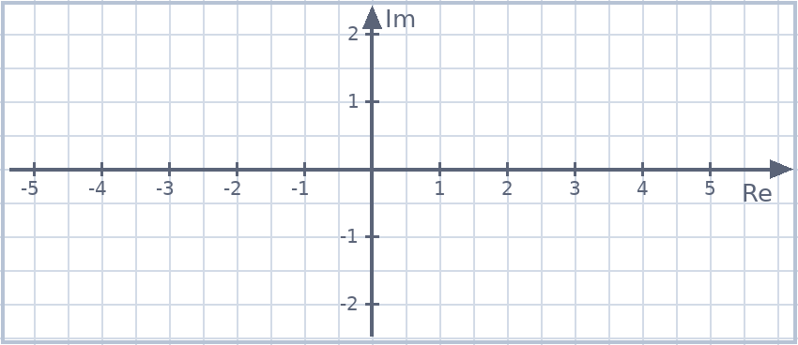
Conjugate and negative in polar form
DEFINITION
Geometry of $\overline{z}$ and $−z$
If $z=r cis θ$ then $\overline{z}=r cis\left(−θ\right)$ (reflect in the real axis) and $−z=r cis\left(θ±π\right)$ (rotate ${180}^{∘}$).
Choose $+π$ or $−π$ to land in $(−π,π]$.
Example 6
Let $z=2 cis \frac{π}{6}$. Write in polar form: (a) $\overline{z}$ (b) $−z$ (c) $−\overline{z}$. (d) Plot all four points.
McIntyre Maths · Mathematics Extension 2 · Lesson 5 Modulus–argument form
9

Slide 10

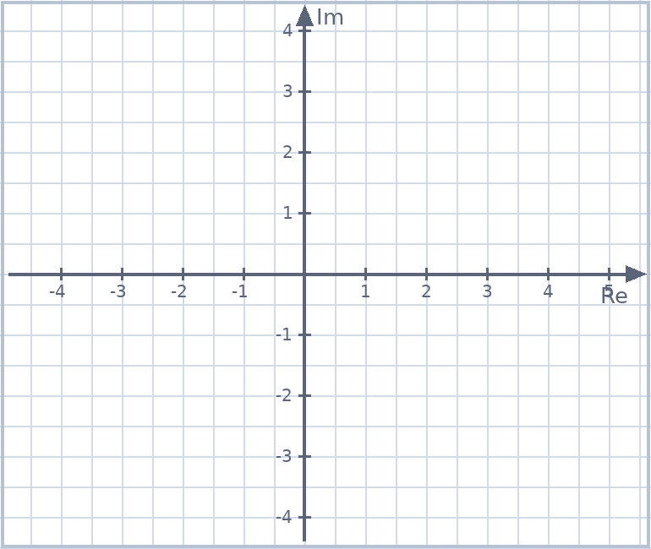
HSC practice · Polar form
HSC PRACTICE
Adapted from 2022 HSC Q11(c)(i)
Let $z=−\sqrt{3}+i$. (i) Find $\left|z\right|$ and $Arg z$. (ii) Write $z$ in the form $r\left(cosθ+isinθ\right)$.
McIntyre Maths · Mathematics Extension 2 · Lesson 5 Modulus–argument form
10

Slide 11

Spot the error · Arguments
SPOT THE ERROR
Each line is a student’s answer. Find the error and correct it.
(a) $z=−2+2i$: $Arg z=\tan^{−1}\left(\frac{2}{−2}\right)=−\frac{π}{4}$
(b) $Arg\left(−4\right)=−π$
(c) $1−\sqrt{3} i=2\left(cos\frac{π}{3}+isin\frac{π}{3}\right)$
(d) $2\left(cos\frac{π}{6}−isin\frac{π}{6}\right)$ has argument $\frac{π}{6}$
McIntyre Maths · Mathematics Extension 2 · Lesson 5 Modulus–argument form
11

Slide 12

Exit ticket
EXIT TICKET
1. Write $−2\sqrt{3}+2i$ in polar form.
2. Express $6\left(cos\left(−\frac{π}{4}\right)+isin\left(−\frac{π}{4}\right)\right)$ as $x+iy$.
3. Explain why $Arg\left(−5\right)=π$ and not $−π$.
Suggested practice: Howard’s 1000 Extension 2 Revision Questions
McIntyre Maths · Mathematics Extension 2 · Lesson 5 Modulus–argument form
12

