Slide 1
Lesson 4 The Argand diagram
Mathematics Extension 2 · Complex Numbers I · ME2-12-03
Learning intention
Success criteria · I can…
Activities & tasks
To represent complex numbers as points in the complex plane and describe simple sets of points.
explain how the complex plane is labelled and where its name comes from
plot $z$, $\overline{z}$, $−z$ and $iz$ and describe each transformation
explain why multiplying by $i$ is a rotation of ${90}^{∘}$ about $O$
sketch $Re\left(z\right)=c$, $Im\left(z\right)=k$ and simple regions
find a locus by letting $z=x+iy$
Howard’s 1000 Extension 2 Revision Questions
Complex Locus Lab
McIntyre Maths · Mathematics Extension 2 · Lesson 4 The Argand diagram
1

Slide 2

Warm-up · Retrieval from Lessons 1–3
WARM-UP
(a) Find real $a$, $b$ with $\left(a+ib\right)\left(1+i\right)=3+i$.
(b) Find the square roots of $2i$.
(c) Find a real quadratic with root $1+2i$.
(d) Find the distance between $\left(1,2\right)$ and $\left(4,6\right)$.
McIntyre Maths · Mathematics Extension 2 · Lesson 4 The Argand diagram
2

Slide 3
Why a plane? · Where the name comes from
BACKGROUND
The number line is full
The real numbers fill every point of the number line, so there is nowhere on it for $i$.
A complex number $x+iy$ is made of two real numbers, so we need two dimensions to show it.
One idea, several names
Argand diagram
complex plane
Argand plane or $z$-plane
1545
Cardano meets square roots of negative numbers while solving cubics
1572
Bombelli writes down the rules for calculating with them
1637
Descartes calls them “imaginary” — and it was not a compliment
1777
Euler introduces the symbol $i$ for $\sqrt{−1}$
1797
Wessel, a Norwegian–Danish surveyor, first draws them as points in a plane
1806
Argand, a Swiss bookkeeper in Paris, publishes the same idea — his name sticks
1831
Gauss makes the plane widely accepted and names them “complex numbers”
McIntyre Maths · Mathematics Extension 2 · Lesson 4 The Argand diagram
3

Slide 4
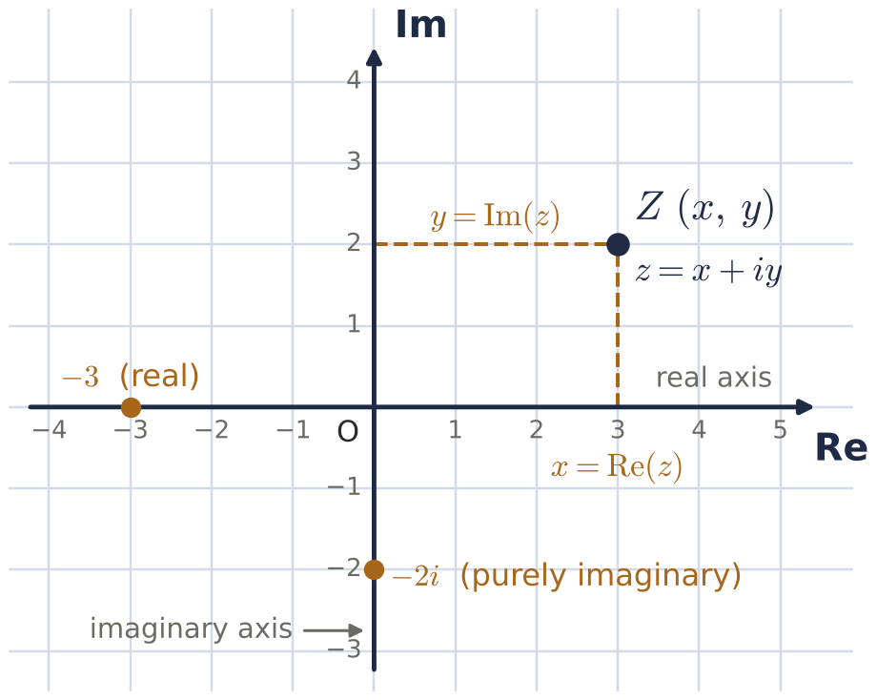
The complex plane · How it is labelled
DEFINITION
Reading the plane
Horizontal: the real axis, labelled Re.
Vertical: the imaginary axis, labelled Im.
$z=x+iy$ is the point $Z\left(x,y\right)$: across $Re\left(z\right)$, up $Im\left(z\right)$.
Real numbers lie on the real axis; purely imaginary numbers lie on the imaginary axis.
Every complex number is exactly one point, and every point is exactly one complex number.
Capital letter for the point ($Z$), lower case for the number ($z$): “the point $Z$ represents $z$”.
McIntyre Maths · Mathematics Extension 2 · Lesson 4 The Argand diagram
4

Slide 5

Check · Reading the plane
CHECK
(a) Write the point for $−3+5i$
(e) Write the number for $\left(−3,0\right)$
(b) Write the point for $2i$
(f) Write the number for $\left(0,3\right)$
(c) Write the point for $7$
(g) Write the number for $\left(7,−5\right)$
(d) Write the point for $\left(2+i\right) i$
(h) Write the number for $\left(a,b\right)$
McIntyre Maths · Mathematics Extension 2 · Lesson 4 The Argand diagram
5

Slide 6

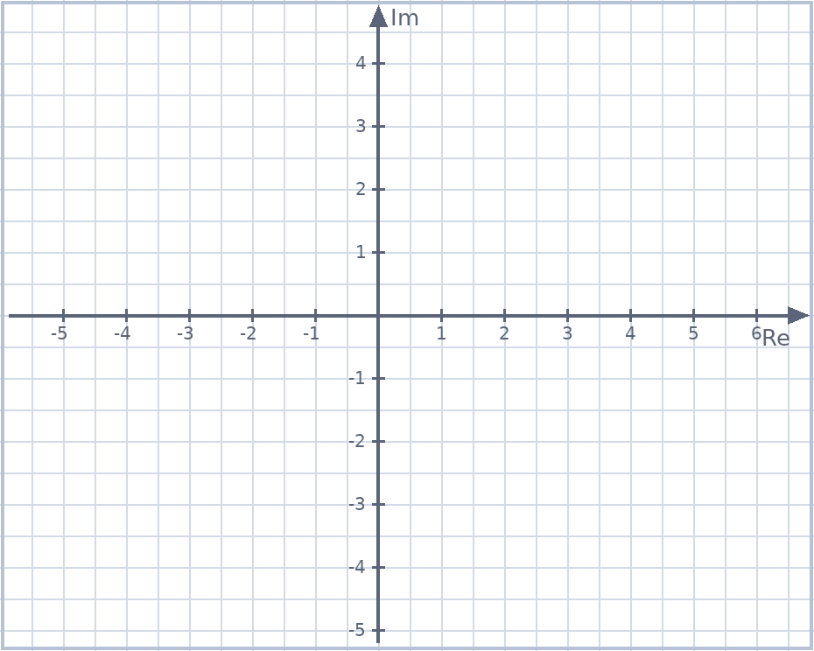
Example 1 · The complex plane
EXAMPLE
Let $z=3+4i$. Plot (a) $z$ (b) $\overline{z}$ (c) $−z$ (d) $iz$. Describe each transformation of $z$.
McIntyre Maths · Mathematics Extension 2 · Lesson 4 The Argand diagram
6

Slide 7

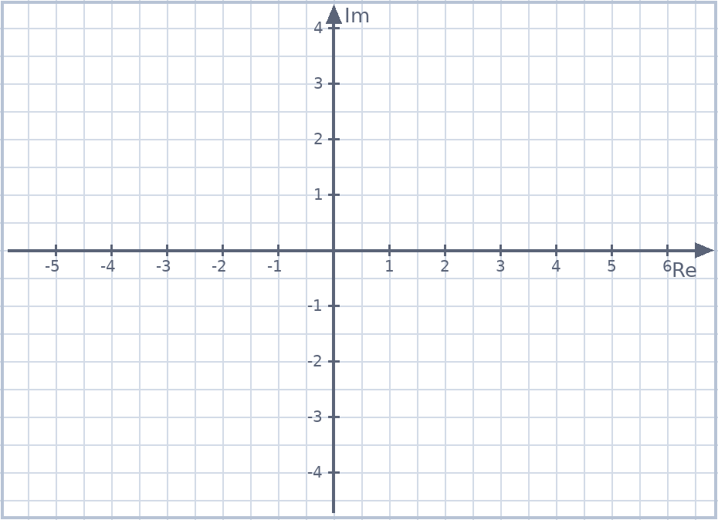
Example 2 · Powers of i on the plane
EXAMPLE
Let $z=1+3i$. The points $A$, $B$, $C$, $D$ represent $z$, $iz$, $i^{2}z$ and $i^{3}z$. (a) Plot them. (b) What type of quadrilateral is $ABCD$? (c) What does multiplying by $i$ appear to do?
McIntyre Maths · Mathematics Extension 2 · Lesson 4 The Argand diagram
7

Slide 8

Example 3 · Why multiplying by i is a rotation
EXAMPLE
The numbers $z=a+ib$ and $w=iz$ ($a,b≠0$) are plotted at $A$ and $B$.
(a) By considering gradients, show that $OA⊥OB$.
(b) Use the distance formula to show that $OA=OB$. What type of triangle is $△OAB$?
McIntyre Maths · Mathematics Extension 2 · Lesson 4 The Argand diagram
8

Slide 9
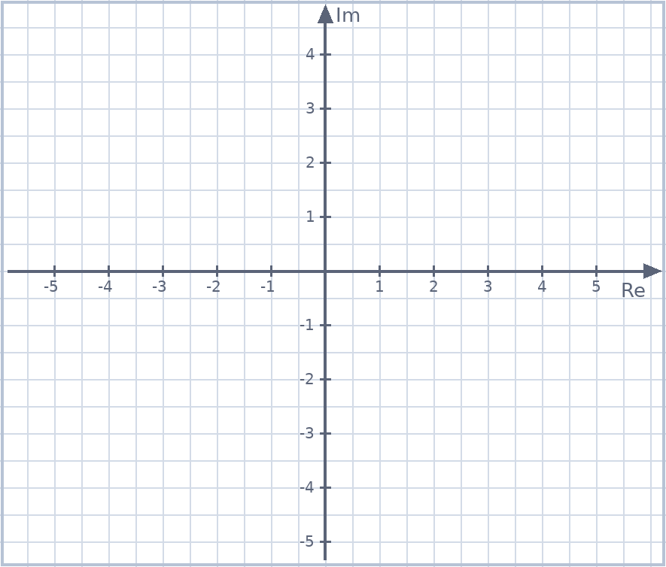
Example 4 · Lines and regions
EXAMPLE
(a) Sketch $Re\left(z\right)=5$ and $Im\left(z\right)=−2$.
(b) Shade the region where $Im\left(z\right)<1$ and $Re\left(z\right)≥−2$.
McIntyre Maths · Mathematics Extension 2 · Lesson 4 The Argand diagram
9

Slide 10

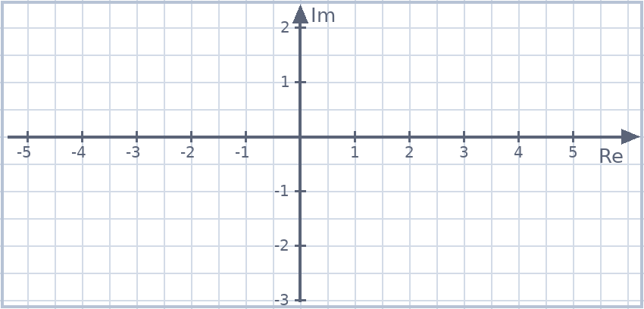
Loci
DEFINITION
Finding a locus
A locus is the set of all points $z$ satisfying a condition — your note: "a path, the allowed set of points".
Method: let $z=x+iy$, simplify to a Cartesian equation, then recognise and sketch the curve.
Example 5
Given that $z\overline{z}=4$, find the locus of $z$ and sketch it.
McIntyre Maths · Mathematics Extension 2 · Lesson 4 The Argand diagram
10

Slide 11

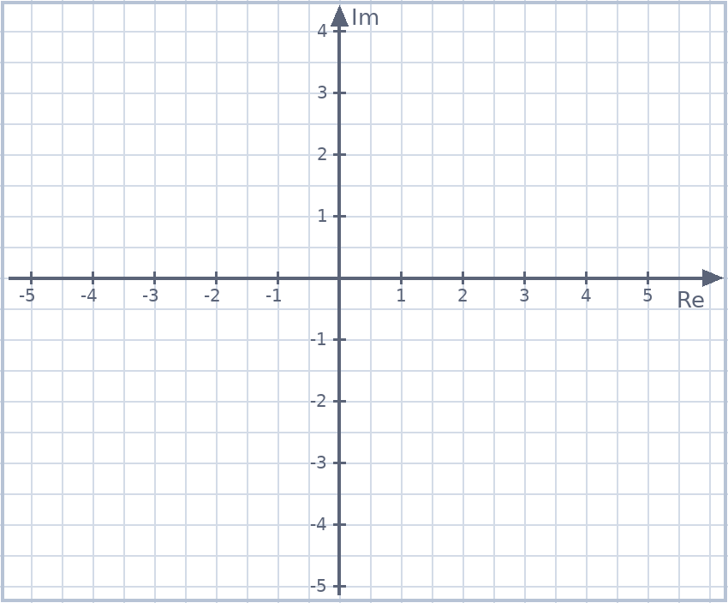
Example 6 · A locus with fractions
EXAMPLE
Given that $\frac{1}{z}+\frac{1}{\overline{z}}=1$, find the locus of $z$ and sketch it.
McIntyre Maths · Mathematics Extension 2 · Lesson 4 The Argand diagram
11

Slide 12

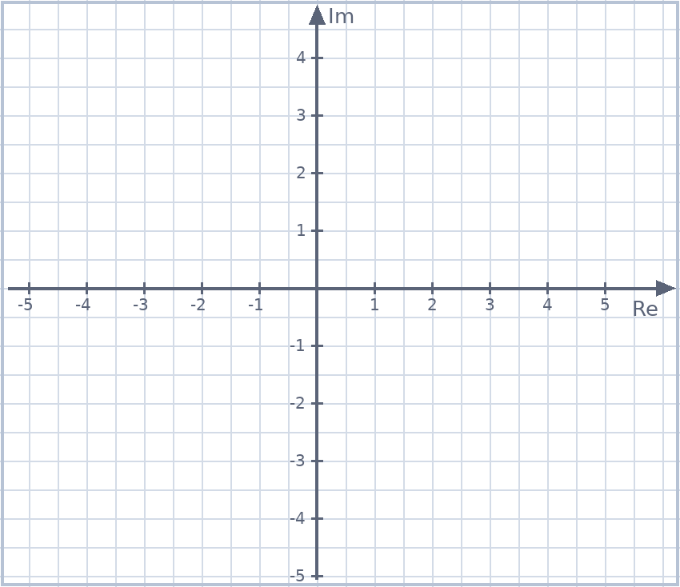
Example 7 · Show that it is a circle
EXAMPLE
Show that $\left(z−2\right)\left(\overline{z}−2\right)=9$ represents a circle in the Argand diagram, and sketch it.
McIntyre Maths · Mathematics Extension 2 · Lesson 4 The Argand diagram
12

Slide 13
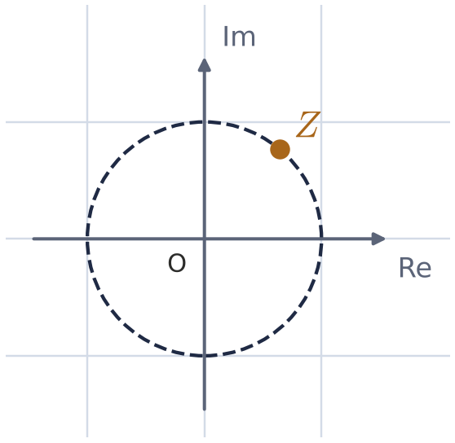

Exam practice · Multiple choice
EXAM PRACTICE
Adapted from Howard Rev Q35
Adapted from 2024 Trial (Hurlstone) Q1
Which equation describes the circle with centre $O$ and radius $2$?
(A) $z\overline{z}=2$
(B) ${\left(z+\overline{z}\right)}^{2}−{\left(z−\overline{z}\right)}^{2}=16$
(C) $Re\left(z\right)+Im\left(z\right)=2$
(D) ${\left|z\right|}^{2}=2$
$Z$ lies on the unit circle in the first quadrant, as shown. Where does $W=\frac{1}{Z}$ lie?
McIntyre Maths · Mathematics Extension 2 · Lesson 4 The Argand diagram
13

Slide 14
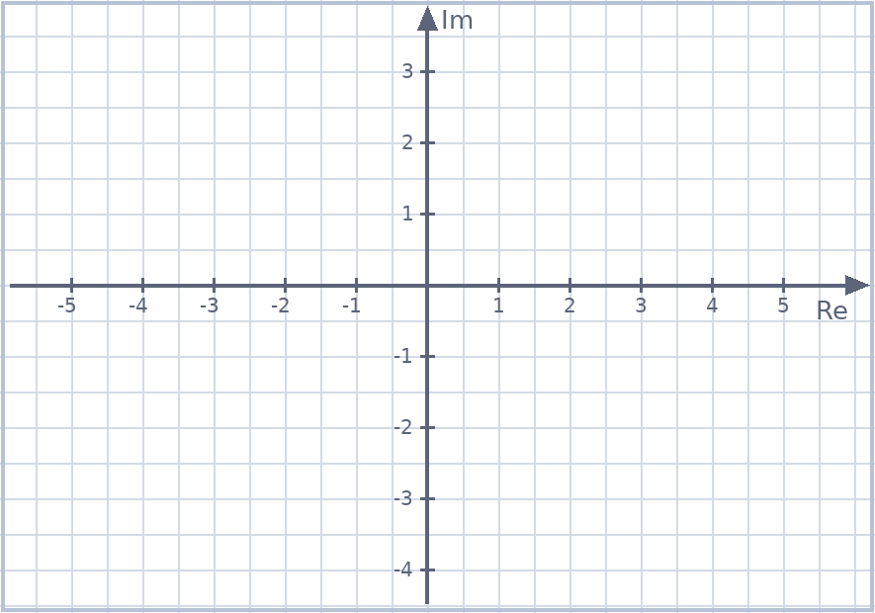
Exit ticket
EXIT TICKET
1. Let $z=−2+i$. Plot $z$, $\overline{z}$ and $iz$ on one Argand diagram.
2. Find and sketch the locus of $z$ if $Im\left(z^{2}\right)=0$.
Suggested practice: Howard’s 1000 Extension 2 Revision Questions
McIntyre Maths · Mathematics Extension 2 · Lesson 4 The Argand diagram
14

