Slide 1
Lesson 10 Rays and regions
Mathematics Extension 2 · Complex Numbers I · ME2-12-03
Learning intention
Success criteria · I can…
Activities & tasks
To sketch rays and regions defined by argument and modulus conditions, and find extreme values on them.
graph $arg\left(z−z_{1}\right)=θ$ as a ray from $z_{1}$, with $z_{1}$ excluded
sketch regions that combine circles, lines and rays, with correct boundaries and endpoints
find the greatest and least $\left|z\right|$ and $argz$ in a region
(extension) use circle geometry for arc loci
Howard’s 1000 Extension 2 Revision Questions
Complex Locus Lab
Arcs on the Complex Plane (1 of 4)
McIntyre Maths · Mathematics Extension 2 · Lesson 10 Rays and regions
1

Slide 2

Warm-up · Retrieval from Lesson 5 and Lesson 9
WARM-UP
(a) Find $Arg\left(−1−i\right)$.
(b) Describe the region $\left|z−1\right|≤2$.
(c) A circle has centre $\left(2,0\right)$ and radius $1$. A tangent from $O$ touches it at $T$. Find $∠TOX$, where $X$ is on the positive real axis.
(d) Write $tan\frac{π}{3}$ exactly.
McIntyre Maths · Mathematics Extension 2 · Lesson 10 Rays and regions
2

Slide 3

Rays
DEFINITION
Argument fixes a direction
$arg\left(z−z_{1}\right)=θ$: the vector from $Z_{1}$ to $Z$ makes angle $θ$ with the positive real direction.
The locus is a ray starting at $z_{1}$; the point $z_{1}$ itself is excluded (open circle), because $arg0$ is undefined.
McIntyre Maths · Mathematics Extension 2 · Lesson 10 Rays and regions
3

Slide 4
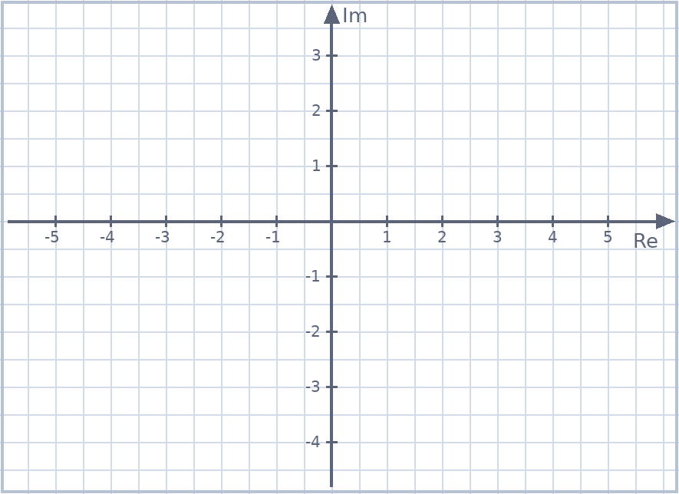
Example 1 · Rays
EXAMPLE
Sketch each locus.
(a) $argz=\frac{π}{6}$
(b) $arg\left(z−\left(1+i\right)\right)=\frac{π}{6}$
McIntyre Maths · Mathematics Extension 2 · Lesson 10 Rays and regions
4

Slide 5
Example 2 · More rays
EXAMPLE
Sketch each locus.
(a) $arg\left(z+2\right)=\frac{3π}{4}$
(b) $arg\left(z−1+i\right)=arg\left(z+1−i\right)$
McIntyre Maths · Mathematics Extension 2 · Lesson 10 Rays and regions
5

Slide 6
Example 3 · Regions
EXAMPLE
Sketch each region.
(a) $1≤\left|z\right|≤3$
(b) $\frac{π}{6}≤argz≤\frac{π}{3}$
McIntyre Maths · Mathematics Extension 2 · Lesson 10 Rays and regions
6

Slide 7
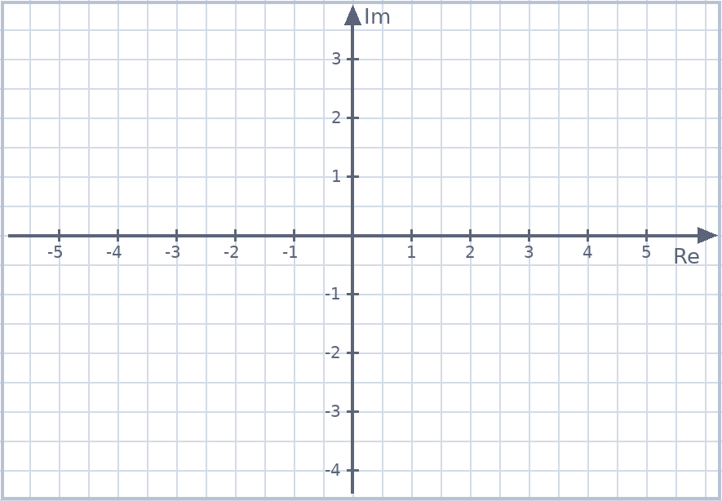
HSC practice · Regions
HSC PRACTICE
Adapted from 2022 HSC Q1
Adapted from 2024 HSC Q11(f)
Sketch the region where $Re\left(z\right)>1$ and $Arg z<\frac{π}{3}$.
Sketch the region where $\left|z\right|<3$ and $0≤arg\left(z−i\right)≤\frac{π}{2}$.
McIntyre Maths · Mathematics Extension 2 · Lesson 10 Rays and regions
7

Slide 8

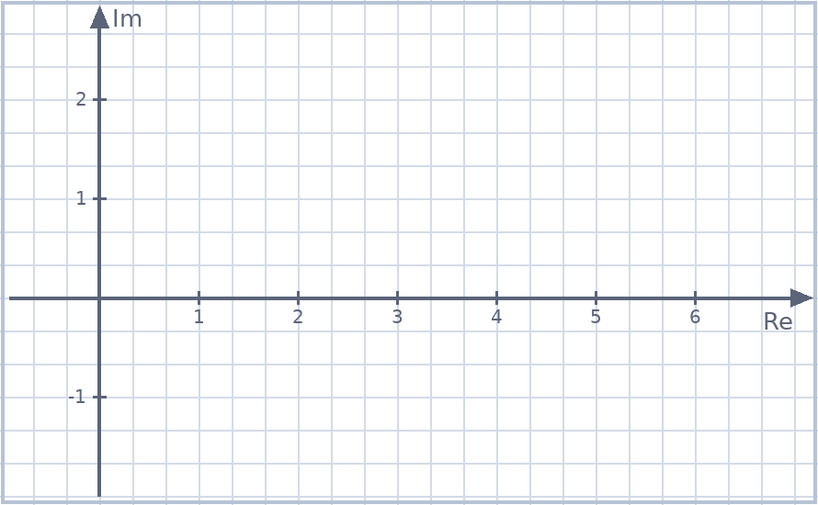
Example 4 · Greatest and least values
EXAM PRACTICE
Howard Rev Q37
$P$ represents $z$, where $\left|z−2\right|=1$. (i) Sketch the locus. (ii) Find the greatest and least values of $\left|z\right|$ and of $argz$.
(iii) $OP_{1}$ and $OP_{2}$ are tangents to the locus. Write $z_{1}$ and $z_{2}$ in polar form.
McIntyre Maths · Mathematics Extension 2 · Lesson 10 Rays and regions
8

Slide 9

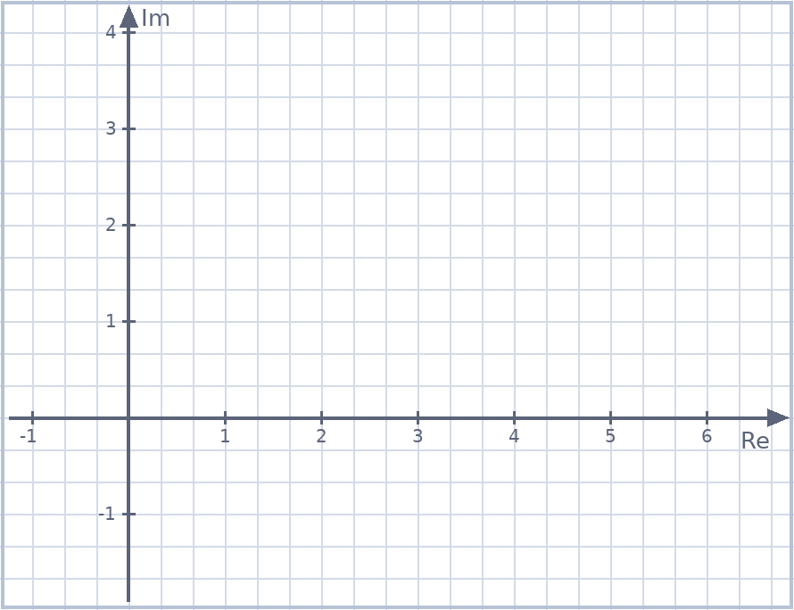
Example 5 · A region and its extremes
EXAMPLE
Sketch the region where $\left|z−1−i\right|≤\sqrt{2}$ and $0≤argz≤\frac{π}{4}$.
Find the greatest value of $\left|z\right|$ in the region, and the point where it occurs.
McIntyre Maths · Mathematics Extension 2 · Lesson 10 Rays and regions
9

Slide 10

Extension · Arcs
EXTENSION
Angle subtended by a fixed interval
$arg\left(\frac{z−z_{1}}{z−z_{2}}\right)=arg\left(z−z_{1}\right)−arg\left(z−z_{2}\right)=θ$: the interval $Z_{2}Z_{1}$ subtends a constant angle $θ$ at $Z$.
So $Z$ lies on an arc of a circle (angles in the same segment are equal); $z_{1}$ and $z_{2}$ are excluded.
McIntyre Maths · Mathematics Extension 2 · Lesson 10 Rays and regions
10

Slide 11

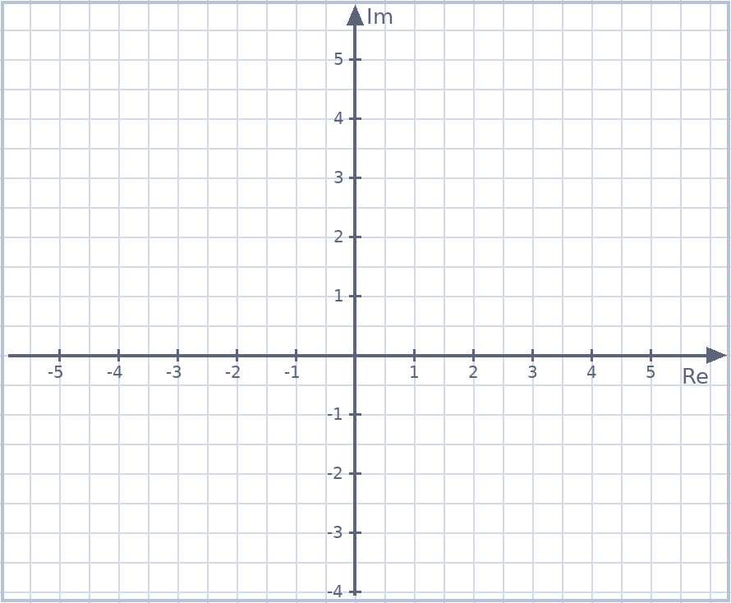
Example 6 · An arc locus
EXTENSION
Sketch the locus given by $arg\left(z−2\right)−arg\left(z+2\right)=\frac{π}{3}$, and find the centre and radius of the circle.
McIntyre Maths · Mathematics Extension 2 · Lesson 10 Rays and regions
11

Slide 12

Spot the error · Rays and regions
SPOT THE ERROR
Each statement is wrong. Find the error and correct it.
(a) $argz=\frac{π}{4}$ is the line $y=x$.
(b) $arg\left(z−1\right)=\frac{π}{2}$ is a ray starting at $O$.
(c) In $1≤\left|z\right|≤3$ both circles are dashed.
(d) The region $\frac{π}{6}≤argz≤\frac{π}{3}$ includes the origin.
McIntyre Maths · Mathematics Extension 2 · Lesson 10 Rays and regions
12

Slide 13
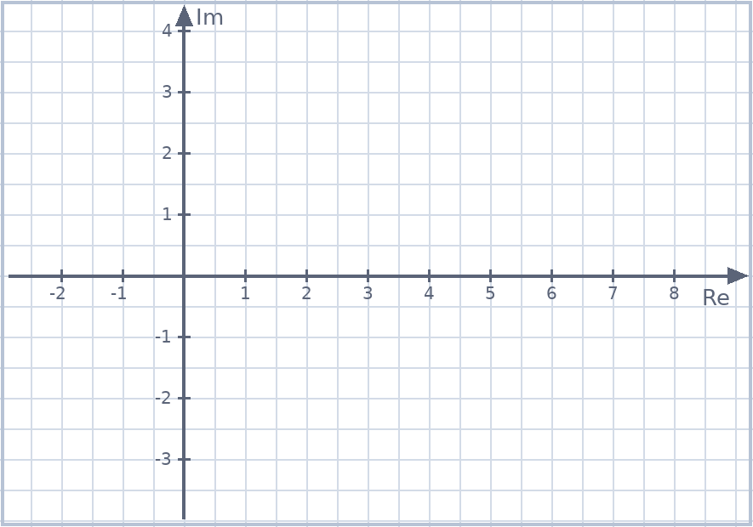
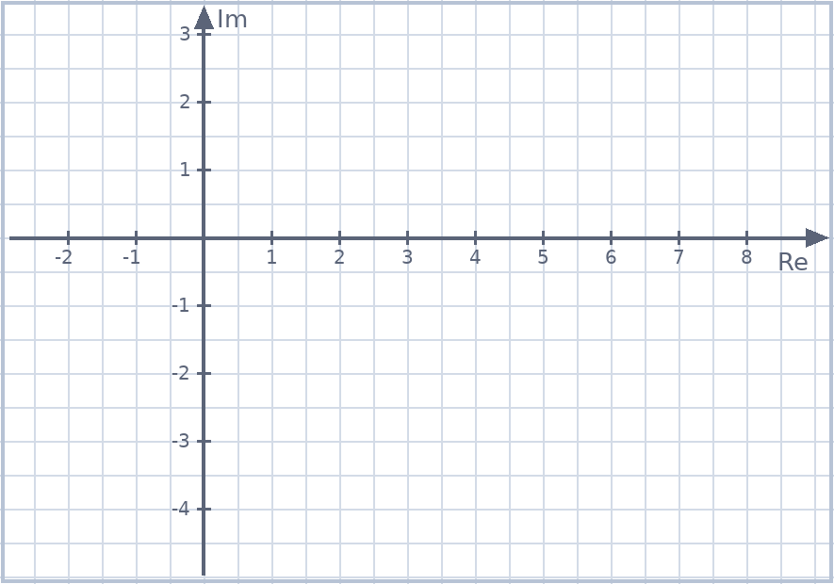
Exit ticket
EXIT TICKET
1. Sketch the region $\left|z−2\right|≤2$ and $Im\left(z\right)≥1$.
2. Find the least value of $\left|z\right|$ if $arg\left(z−2i\right)=−\frac{π}{4}$.
Suggested practice: Howard’s 1000 Extension 2 Revision Questions
McIntyre Maths · Mathematics Extension 2 · Lesson 10 Rays and regions
13

