Slide 1
Lesson 1 The arithmetic of complex numbers
Mathematics Extension 2 · Complex Numbers I · ME2-12-03
Learning intention
Success criteria · I can…
Activities & tasks
To extend the number system to include $i$ and the complex numbers, and to add, subtract and multiply complex numbers.
define $i$ by $i^{2}=−1$ and simplify powers of $i$
solve $x^{2}+k=0$ where $k>0$
classify numbers as $N$, $Z$, $Q$, $R$ or $C$
identify $Re\left(z\right)$ and $Im\left(z\right)$
add, subtract and multiply complex numbers
Howard’s 1000 Extension 2 Revision Questions
How Imaginary Numbers Were Invented (Veritasium)
Imaginary Numbers Are Real, Part 1 (Welch Labs)
McIntyre Maths · Mathematics Extension 2 · Lesson 1 The arithmetic of complex numbers
1

Slide 2

Warm-up · Why do we need a new number?
WARM-UP
Consider $x^{2}+2x+4=0$.
(a) Find the sum and product of the roots. (b) Use the quadratic formula. What goes wrong?
McIntyre Maths · Mathematics Extension 2 · Lesson 1 The arithmetic of complex numbers
2

Slide 3

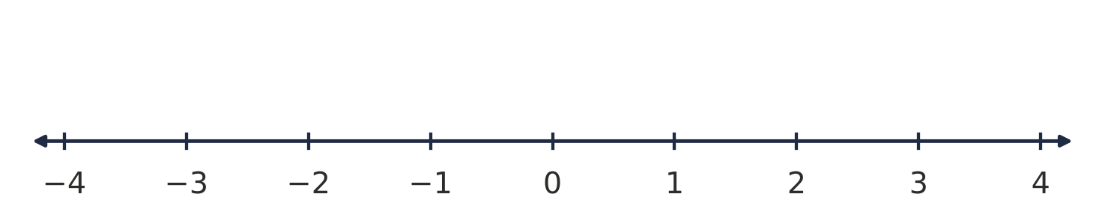
Think · Multiplying on the number line
DISCUSSION
Multiplying by $−1$ turns a number through ${180}^{∘}$ about $0$.
What operation, done twice, gives a half-turn? Where does that take the number $1$?
McIntyre Maths · Mathematics Extension 2 · Lesson 1 The arithmetic of complex numbers
3

Slide 4

The imaginary number i
DEFINITION
The number $i$
$i$ is defined by $i^{2}=−1$. So $x^{2}=−1$ has the two solutions $x=±i$.
For $k>0$: $x^{2}+k=0 ⇒ x=±i\sqrt{k}$.
Careful: $\sqrt{a}\sqrt{b}=\sqrt{ab}$ only holds for $a,b≥0$. For example, $\sqrt{−4}×\sqrt{−9}=2i×3i=−6$, not $\sqrt{36}=6$.
Example 1
Solve: (a) $x^{2}+9=0$ (b) $x^{2}+5=0$ (c) $4x^{2}+49=0$
McIntyre Maths · Mathematics Extension 2 · Lesson 1 The arithmetic of complex numbers
4

Slide 5

Example 2 · Powers of i
EXAMPLE
Simplify each power of $i$.
(a) $i^{2}$
(f) $i^{7}$
(b) $i^{3}$
(g) $i^{8}$
(c) $i^{4}$
(h) $i^{40}$
(d) $i^{5}$
(i) $i^{50}$
(e) $i^{6}$
(j) $i^{231}$
McIntyre Maths · Mathematics Extension 2 · Lesson 1 The arithmetic of complex numbers
5

Slide 6

Powers of i · The cycle of four
HSC PRACTICE
Powers of $i$ repeat every four
$i^{4k}=1, i^{4k+1}=i, i^{4k+2}=−1, i^{4k+3}=−i \left(k∈Z\right)$
Divide the index by 4: the remainder decides the value.
2021 HSC Q11(b)
HSC question
Evaluate $i+i^{2}+i^{3}+i^{4}+i^{5}$.
McIntyre Maths · Mathematics Extension 2 · Lesson 1 The arithmetic of complex numbers
6

Slide 7

The complex numbers
DEFINITION
Complex numbers $C=\{a+ib: a,b∈R\}$
A complex number has the form $z=a+ib$, where $a$ and $b$ are real.
$a=Re\left(z\right)$ is the real part
$b=Im\left(z\right)$ is the imaginary part — a real number, not $bi$.
If $Re\left(z\right)=0$ and $b≠0$, $z$ is purely imaginary.
Example 3
Write down $Re\left(z\right)$ and $Im\left(z\right)$ for: (a) $3+4i$ (b) $−2i$ (c) $7$ (d) $\frac{1−i\sqrt{5}}{2}$
McIntyre Maths · Mathematics Extension 2 · Lesson 1 The arithmetic of complex numbers
7

Slide 8
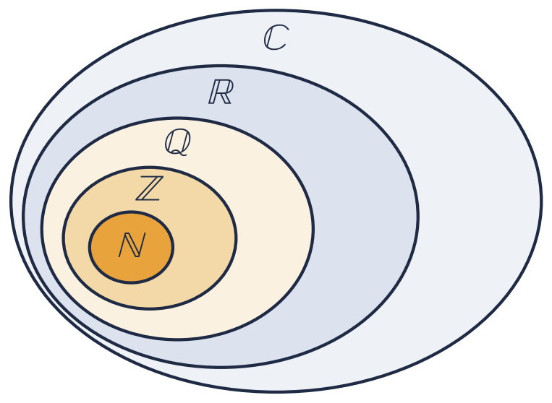
Example 4 · Classifying numbers
EXAMPLE
Place each number in the smallest set it belongs to.
$5$
$−8$
$\frac{18}{6}$
$sin\frac{π}{6}$
$\frac{22}{7}$
$π$
$\sqrt{49}$
$\sqrt{5}$
$2+3i$
$4i$
McIntyre Maths · Mathematics Extension 2 · Lesson 1 The arithmetic of complex numbers
8

Slide 9

Arithmetic in ℂ
DEFINITION
Adding, subtracting and multiplying
Treat $i$ like a pronumeral (a special one!) and replace $i^{2}$ with $−1$.
$\left(a+ib\right)±\left(c+id\right)=\left(a±c\right)+i\left(b±d\right)$
$\left(a+ib\right)\left(c+id\right)=\left(ac−bd\right)+i\left(ad+bc\right)$
Check answers on your calculator in complex mode (syllabus: “with and without digital tools”).
Example 5
Express in the form $a+ib$: (a) $\left(3+4i\right)+\left(2+6i\right)$ (b) $\left(4−3i\right)−\left(2−4i\right)$ (c) $\left(3+2i\right)\left(4+2i\right)$
McIntyre Maths · Mathematics Extension 2 · Lesson 1 The arithmetic of complex numbers
9

Slide 10

Example 6 · Multiplying
EXAMPLE
Express in the form $a+ib$.
(a) $\left(2+5i\right)\left(3+6i\right)$
(b) $\left(3+2i\right)\left(3−2i\right)$
(c) $\left(a+ib\right)\left(a−ib\right)$
McIntyre Maths · Mathematics Extension 2 · Lesson 1 The arithmetic of complex numbers
10

Slide 11

HSC practice · Expanding a power
HSC PRACTICE
Adapted from 2023 HSC Q1
Expand ${\left(a+ib\right)}^{3}$, where $a,b∈R$, and write it in the form $x+iy$.
Hence find ${\left(2−i\right)}^{3}$.
McIntyre Maths · Mathematics Extension 2 · Lesson 1 The arithmetic of complex numbers
11

Slide 12

Exit ticket
EXIT TICKET
1. Simplify $i^{2027}$.
2. Express ${\left(1+i\right)}^{4}$ in the form $a+ib$.
3. Find $Re\left(z\right)$ and $Im\left(z\right)$ if $z=\left(2−i\right)\left(3+4i\right)$.
Suggested practice: Howard’s 1000 Extension 2 Revision Questions
McIntyre Maths · Mathematics Extension 2 · Lesson 1 The arithmetic of complex numbers
12

